Slide 1
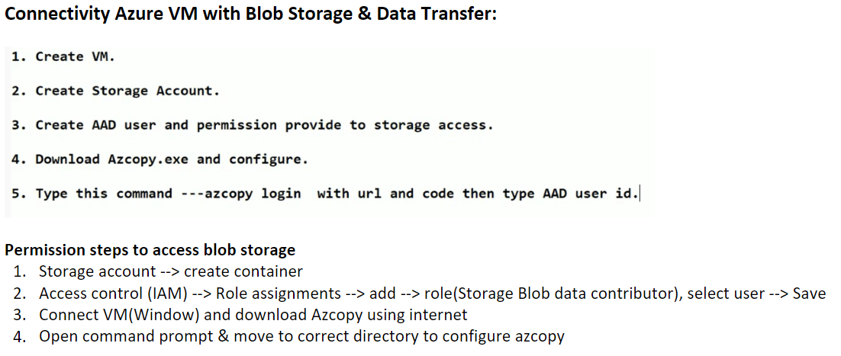
Link: Data Transfer from VM to Blob Storage

Slide 2
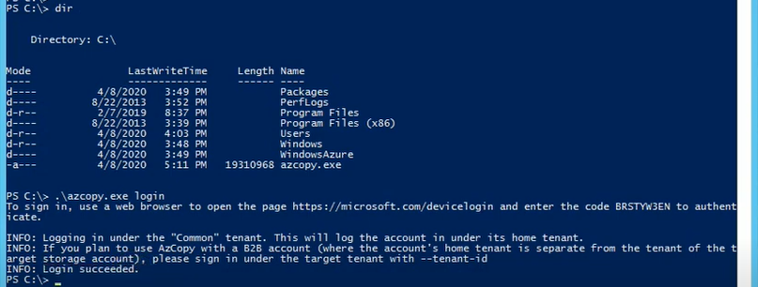


Slide 3
